Slide 1
Object Oriented Programming Lecture-10
Jagged arrays, passing array to a function
Prof. Varsha Dange

Slide 2
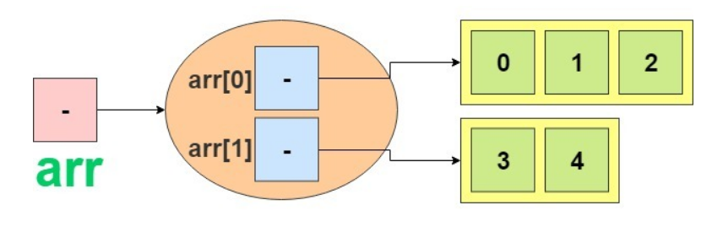
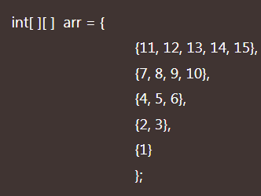
Jagged Array in Java
Since each row in a two dimensional array is itself an array, therefore, rows can have different lengths or sizes.
we can create a 2-D arrays but with variable number of columns in each row.
A two-dimensional array with different rows is called jagged array in java. Example Example1

Slide 3
Passing arrays to methods in Java
like primitive type values and objects ,it is also possible to pass arrays and individual array elements as arguments to methods and returns arrays from methods.
When we pass an array argument to a method in java, actually, the reference of the array is passed to the method, not value.
Once an array is passed as an argument to a method, all elements of the array can be accessed by statements of the method.

Slide 4
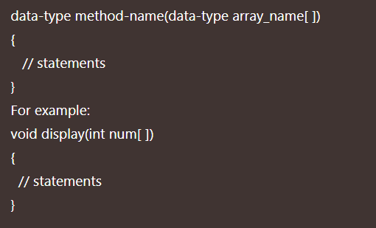
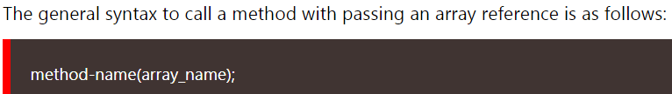
Passing One-dimensional Array as Arguments to Method in Java
A method that will take an array reference through a method call, method’s parameter list must define an array parameter. The general syntax:
Here, pair of square brackets after the array name indicates that we are passing an array.
while calling a method , we need to pass the array name of actual array as an argument to a method.
To pass an array as an argument to a method, specify the name of array without any brackets.

Slide 5
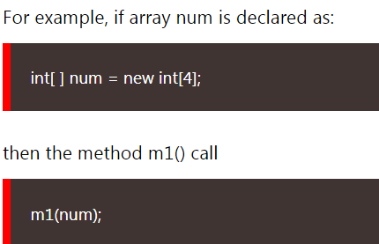

Passing One-dimensional Array as Arguments to Method in Java
Here, we are passing the reference of the array num to a method m1().
When we pass the reference of an array object into a method, do not need to pass array length as an additional argument.
We can also pass an anonymous array as an argument to a method while calling the method.
Example

Slide 6
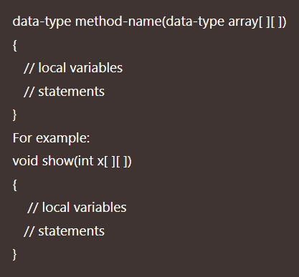
Passing Two-dimensional Arrays to Methods in Java
For a method to take a two dimensional array as its argument, we must specify two dimensional array name followed by two pairs of square brackets preceded by the data type of array.
Example

Slide 7
Passing Array to a Method in Java
Arrays are always passed by reference in java.
Arrays are passed to functions just like ordinary variable passing.
in Java, Arrays are objects(reference variable). An object actually holds a memory address where the values are stored.
When an argument of an array type is passed to a method, the value of an argument is actually the reference to an array that contains a copy of the memory address where values are stored.
if we make a change to an array passed to a method, the original array is also affected.
Example1

